Slide 1
ASP.NET Core
Totally not an a conclusive guide…

Slide 2
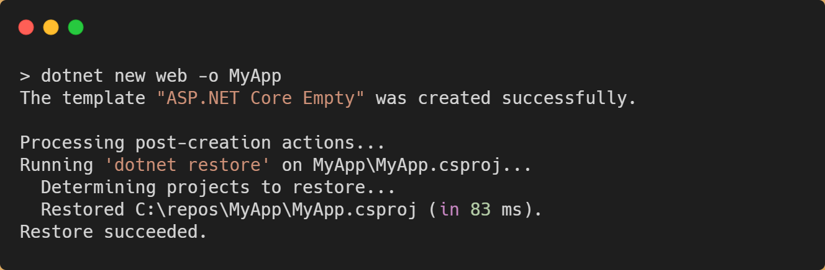

Slide 3
ASP.NET Core
Internet
Request
Routing Engine
Controllers
Actions
Response

Slide 4
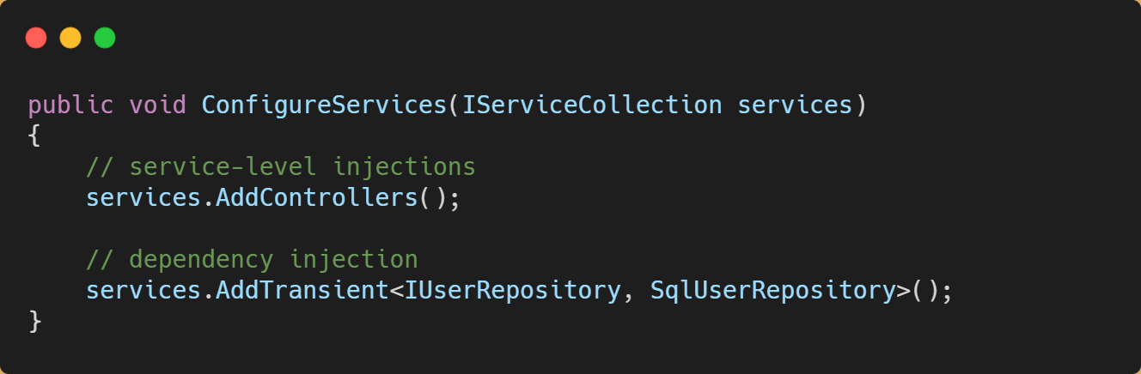
Startup.cs | ConfigureServices

Slide 5
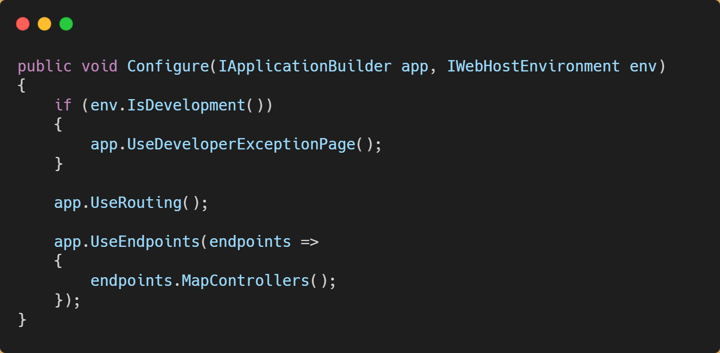
Startup.cs | Configure

Slide 6
Controllers and Actions
Notes:
In this section, we’ll introduce you to the concept on Controllers and Actions in ASP.NET. These are vital concepts for you to understand in your pursuit of building APIs.

Slide 7
Controllers
ASP.NET Core
public async Task<IActionResult> GetProducts()
{
var products =
_productRepository.GetProducts();
return Ok(products);
}
GET /api/products
Notes:
The concept of Controllers and Actions have been in ASP.NET since 2007, when ASP.NET MVC was introduced.
If you’re new to the concept of controllers and actions, let’s start with the fundamental goal: we want to translate incoming HTTP requests into method calls.

Slide 8
Controllers
ASP.NET Core
ProductsController
GetProducts()
GetProduct(string id)
CreateProduct()
UpdateProduct()
DeleteProduct()
GET /api/products
Notes:
In the Controller pattern, we use special classes, called Controllers to separate and contain logic for communicating with resources outside of the application.

Slide 9
Controllers
ASP.NET Core
ProductsController
GetProducts()
GetProduct(string id)
CreateProduct()
UpdateProduct()
DeleteProduct()
GET /api/products
Notes:
Inside of the controller, we have public methods – called Actions – which help the controller direct traffic to an intended method.
For example, I want a GET request to /api/products to hit the ACTION on my CONTROLLER called GetProducts. The intent here is that, based of the VERB and PATH, ASP.NET will create a new instance my ProductsController and execute the GetProducts method (or action) on my behalf.

Slide 10
Controllers
ASP.NET Core
ProductsController
Routing Engine
GET /api/products
OrdersController
InvoiceController
Notes:
But how does ASP.NET know what to do in these cases?
We’ll discuss this in greater detail in a later module, but ASP.NET has a robust routing engine whose sole job is to determine where your requests should go. As your applications grow overtime, you’ll end up with dozens of controllers which each do their own thing.

Slide 11
Controllers
ASP.NET Core
public async Task<IActionResult> GetProducts()
{
var products =
_productRepository.GetProducts();
return Ok(products);
}
GET /api/products
[ { productId: 1, productName: “Foo”},
{productId: 2, productName: “Bar”}]
Notes:
Getting to the correct Action is only the first part of the equation. The Controller is also responsible for making sure a correctly formatted response is sent back to the client making the call.
In this example, our ACTION is returning a list of products with the status code 200 OK.

Slide 12
Simple Rules for Controllers
Controllers should be dumb
Notes:
We’re going to spend a lot of time building and customizing controllers, but there are a couple keys to keep in mind
First – your controllers should be dumb. There should be very little business logic in controllers. If you’re API is designed to return a list of products, your controller shouldn’t know the database where the products are. It shouldn’t know how to connect to the database.
Your controller should be able to ask a repository or a service to get a list of products and then the controller can return them.
But your controller should rarely have business logic inside of it. All the example we’ll do in this course practice this concept.

Slide 13
Simple Rules for Controllers
Controllers should be dumb
Controllers should validate inputs
Notes:
Controllers should validate inputs.
We’ll talk more about this in the future, but there is a simple rule in API design and that is you should never trust the client sending you data. Validate EVERYTHING if it is critical to your application performing correctly.
There are great tools built into ASP.NET to assist you with this process.

Slide 14
Simple Rules for Controllers
Controllers should be dumb
Controllers should validate inputs
Controllers should validate access
Notes:
Controllers should validate access.
Remember – never trust anything from the client. That includes who they say they are. If you need to protect your endpoints, it’s important that you ensure the requests coming in are able to perform the actions they’re requesting.
Imagine you’re building a Users Controller, and you have a Delete action that can potentially delete one or more users from your systems. You’d like to ensure that anyone that makes that call is authorized to do so!

Slide 15
Dependency Injection
Notes:
In this section, we’re going to cover dependency injection. What is it, why you should use it, and how to take advantage of it in your APIs.

Slide 16
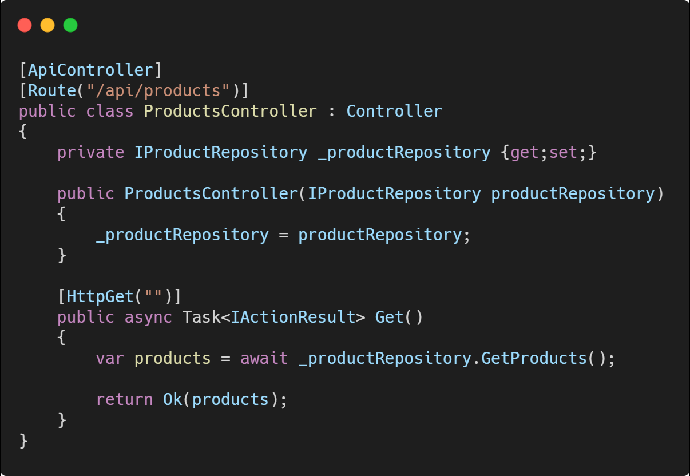
Dependency Injection
Notes:
I know what you’re probably thinking. Why is dependency injection a topic in a course on building APIs?
And that’s a great question. The quick answer is because you’re going to use it EVERYWHERE.
If you’re new to dependency injection, let’s discuss a little bit of what it is?
We’ve previously talked about that Controllers in ASP.NET should be dumb – or not have much business logic in them. But how do you go about telling your controllers where they can go to perform these actions?
It’s best practice for this to be done via dependency injection.

Slide 17
Dependency Injection
Notes:
In the constructor of this sample Controller, we’re passing in a parameter of the type IProductRepository. Since it’s “I” ProductRepository, we don’t necessarily care what type of object we get. All it has to do is implement IProductRepository and we’ll be happy.
From this code, can you tell me where the content of our “GetProducts” call comes from? SQL Server? Flat file? Or is it randomly generated?
You don’t know! And neither does the controller.

Slide 18
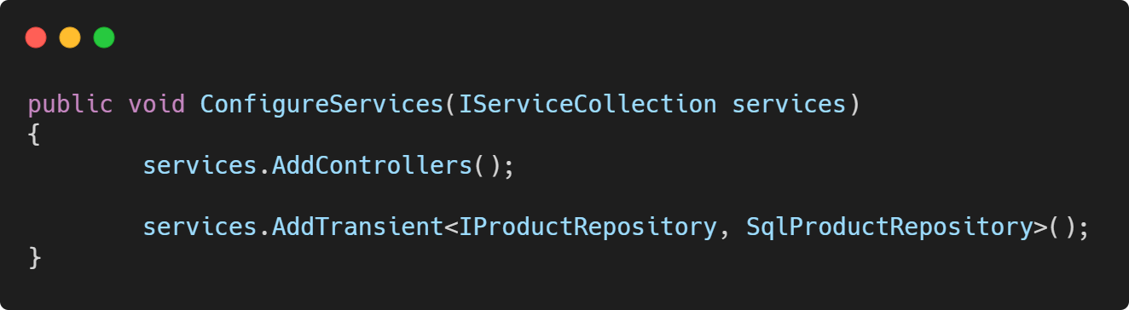
Dependency Injection
Notes:
One important aspect of Controllers is that you will never be responsible for new-ing up a controller instance. ASP.NET does that for you.
But how does ASP.NET know what type object to put in as our IProductRepository?
That’s because we tell it when the application starts up.

Slide 19
Dependency Injection
Notes:
There is a special method in ASP.NET called ConfigureServices, and it’s job is to set up dependency injection throughout ASP.NET.
In this method, we can tell ASP.NET that whenever one of our controllers or other services ask for an IProductRepository, it should create a new instance of a SqlProductRepository and “inject” it into the constructor.
A huge positive of this approach is that if you need to change the implementation of an IProductRepository, say you’ve moved to MongoDB from SQL Server, you just need to write a new implementation and change one line of code in your ConfigureServices method. All your other code should still work without issue!
Let’s walk through a demo to explain this concept a bit deeper.

Slide 20
Building a Simple GET Request
Notes:
In this section, we’ll build out a simple GET request with ASP.NET and walkthrough a couple of the moving parts.

Slide 21
A Simple GET Request
Notes:
Here is an example of a simple, functional API in ASP.NET.
As you’ve probably noticed, it’s a simple class. But let’s look at some of the pieces required for this class work as a “controller” in ASP.NET.

Slide 22
A Simple GET Request
Notes:
ASP.NET identifies controllers in your application by looking for classes that implement the Controller class. This implementation provides you with all the tools you need to handle multiple types of requests.

Slide 23
A Simple GET Request
ControllerBase
Notes:
Sidenote: You can also use “ControllerBase” for you implementation. The big difference here is that Controller also contains logic for returning View logic – or Razors. With API development, this isn’t something you need to worry about, so it’s a small optimization to implement ControllerBase instead of just Controller.
Either way works for any demos we do though.

Slide 24
A Simple GET Request
Automatic 400 Bad Request
Model Binding Assistance
Better errors
Notes:
Your eye is probably also draw to the decorators on the class and on the Action itself.
The APIController attribute is used to help ASP.NET give a heads up that you’re specifically building an API. It’ll do things like:
Enabling automatic 400 Bad Requests if your model binding isn’t valid.
Assisting you with binding data to models
And providing better error details

Slide 25
A Simple GET Request
Notes:
The “Route” attribute and the “HttpGet” attribute tell ASP.NET which paths and verbs should direct to this controller, and specifically which action.
We have an entire section on routing, but this example says that the ProductsController handles all requests that begin with api/products. But it doesn’t specify any verbs!
The Get() action does though, by adding an attribute saying that any GET request to this controller should go through the Get action.
Note: In most cases, the name of the method doesn’t matter. But we’ll cover that more later.

Slide 26
A Simple GET Request
GET /api/products
Notes:
If someone were to make a GET request to api/products – ASP.NET will instantiate our ProductsController and call the GET action.
This action will make a call to our ProductRepository, and return the results.

Slide 27
A Simple GET Request
GET /api/products
Notes:
The return statement is special too!
Returning the OK method creates a 200 OK response, with the content of the products as the payload. This list of products will be converted into JSON and sent to the client for use.
Let’s walk through this simple GET request with a demo.

Slide 28
Demo
Simple Requests

Slide 29
Hands On Lab: ASP.NET Core
If you haven’t already, pull the latest GitHub repo for this workshop
Go to the “/exercises/5_ASPNETCore” folder and open the README.md.
Length: 20 minutes

